Slide 1
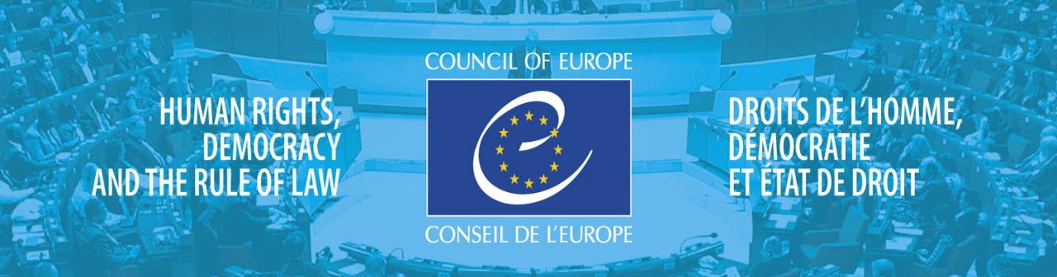
JOURNALISTS UNDER PRESSURE unwarranted interference, fear and self censorship in Europe
Marilyn Clark
Department of Psychology
University of Malta
Notes:
At the centre of the supreme value of democracy and human rights is the right of everyone to receive and impart information.
Freedom of expression is one of the basic conditions for the progress of society and for the development of every person

Slide 2
Journalists
enable public debate
act as public watchdogs
inform on matters of public interest
hold those high in the power structures to account
ensure citizens’ access to the process of governance
Notes:
In order for journalists to be able to fulfil these functions, they must be able to exercise their task of examining the power structures in society without being interfered with or intimidated, and without fearing violence, being threatened, being detained without due reason and being imprisoned. In short, without safeguards for the safety of journalists there is no free media.

Slide 3
The 2017 Report of the Secretary General of the Council of Europe highlights:
journalists must be able to conduct their work free from interference, including the threat of violence and intimidation.
member states fail to guarantee an enabling environment for them and journalists are exposed to threats and violence.
Imprisonment of journalists has reached unprecedented numbers
Notes:
The last decade has seen an increase in the different forms of violence against journalists and public watchdogs. Across Europe a range of tactics are being deployed to silence CRITICAL VOICES AND FREE SPEECH

Slide 4
Rationale and Agenda
Effective prevention requires understanding the magnitude and scope of the problem
Trustworthy statistics form an irreplaceable tool for strategic planning
3 main research questions
Notes:
The last decade has seen an increase in the different forms of violence against journalists and public watchdogs. Across Europe a range of tactics are being deployed to silence CRITICAL VOICES AND FREE SPEECH
Prevalence of unwarranted interference
Perceptions of likelihood/fear of unwarranted interference
Relationship between unwarranted interference, fear and self censorship

Slide 5
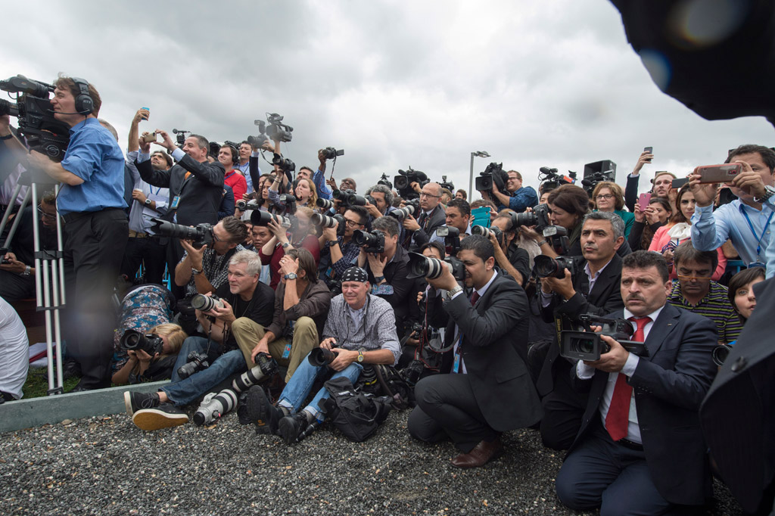
Participants
940 journalists from 47 CoE member States and Belarus;
54% were male and 46% were female;
46% had a journalistic career spanning over 16 years;
The most common medium used for reporting was newspapers (32%), closely followed by the internet (31%);
The most common topic reported on was ‘Politics and Governance’ (32%).

Slide 6
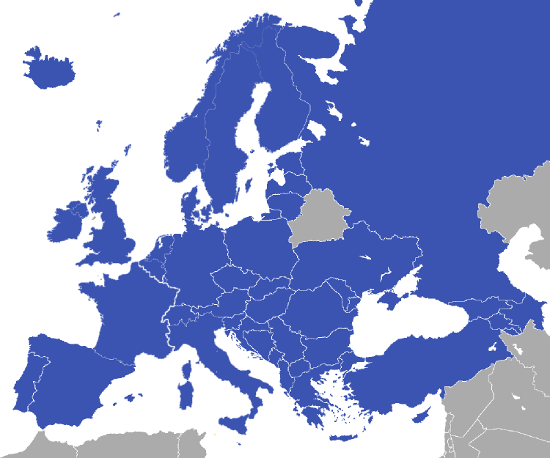
Region reporting from:
214 (23%) Eastern European countries
700 (78%) EU and non-EU Western countries
53 (6%) South Caucasus countries
217 (24%) South-East European countries
116 (13%) Turkey

Slide 7
Experiences of unwarranted interference in the last 3 years

Slide 8
Psychological violence included:
humiliation by public authorities (48%);
intimidation by public authorities (56%);
threats of being hurt by public authorities (41%);
slandering or smear campaigning by public authorities (43%)
and also by other journalists (28%);
belittlement and humiliation by management (24%);
intimidation by management (19%);

Slide 9
Feel protected against targeted surveillance
NO 76%
YES 24%
Notes:
39 % reported having been subjected to targeted surveillance

Slide 10
Protection of Sources
48% Feared that the ability to protect sources was compromised
25%
of respondents reported that sources were
compromised

Slide 11
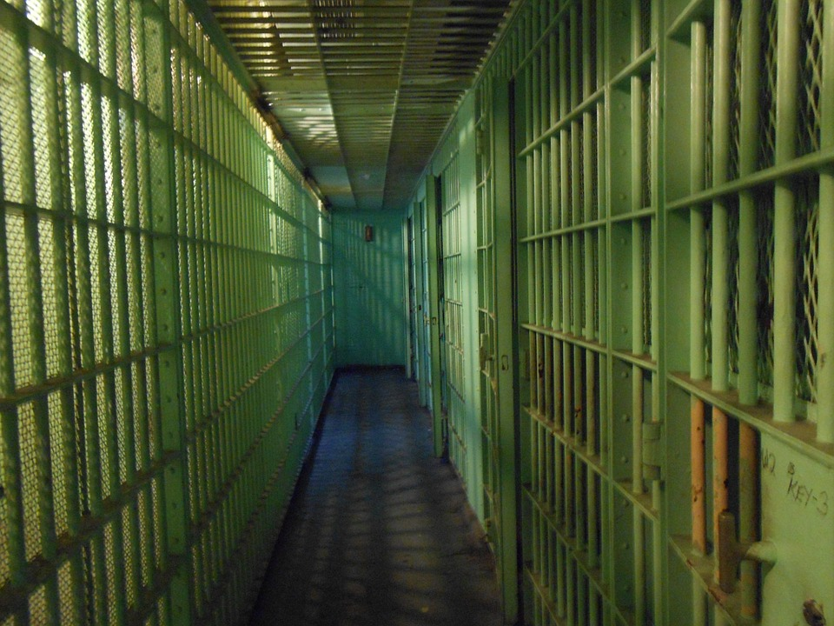
Judicial intimidation
23% of respondents experienced
Arrest
Investigation
Threat of prosecution
Actual prosecution (civil or criminal)
under a number of laws.

Slide 12
Arrests, investigations, threats of prosecution or prosecution, under…
Notes:
The current data also indicates that the use of public order laws, as well as anti-terrorism and national security laws, are being used to silence journalists in their role as public watchdog
Defamation laws that are overly protective of reputational interests and that provide for far-reaching remedies or sanctions can have a chilling effect
The purpose of defamation laws is to protect the reputations of individuals against injury. At the same time, the concept of defamation has to be thought in relation to freedom of expression and public debate. If laws governing defamation/reputation are overly broad, they become susceptible to misuse and abuse and a negative impact on public debate. In the laws of the majority of the Council of Europe member states defamation is defined both as a civil wrong and a criminal offence. In other words, a person can either be sued for compensation by the affected person or be criminally prosecuted by the state. There is a general consensus among the different specialised bodies of international and regional organisations that not only the application of criminal sanctions but also the mere fact that such sanctions could be applied have substantial undesirable effects on freedom of expression and information. The European Court of Human Rights has delivered a voluminous case-law relating to freedom of expression and defamation

Slide 14
Of those who had experienced unwarranted interference
28% of respondents did not report the unwarranted interference to the company in which they worked;
57% did not report it to the police and of those who did report it, 23% were not satisfied with the police response;
Among those who belonged to a union, 40% did not report it to their union;
28% did not feel that they were adequately supported.
Notes:
No effective integrated process
Lack of trust in mechanisms that exist;

Slide 15
Worried about safety…..
 | I worry a lot / I worry somewhat
Worried about personal safety | 38%
Worried about friends’ and family’s safety | 39%
Notes:
Culture of fear

Slide 16
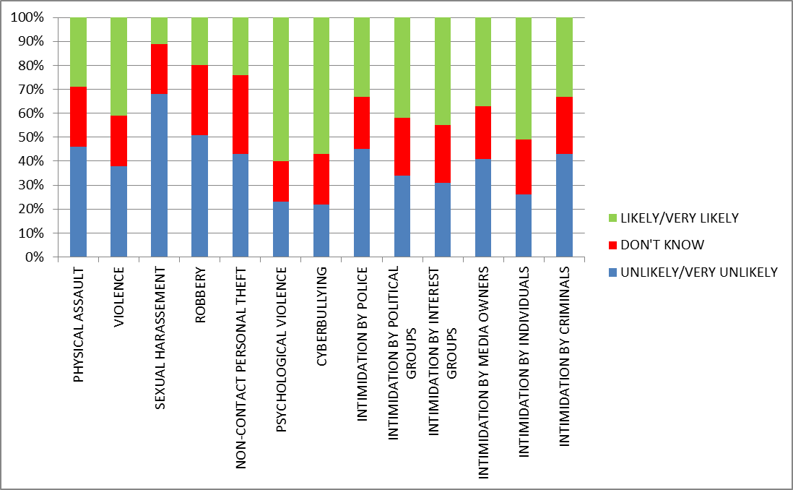
Perception of likelihood of ……

Slide 17
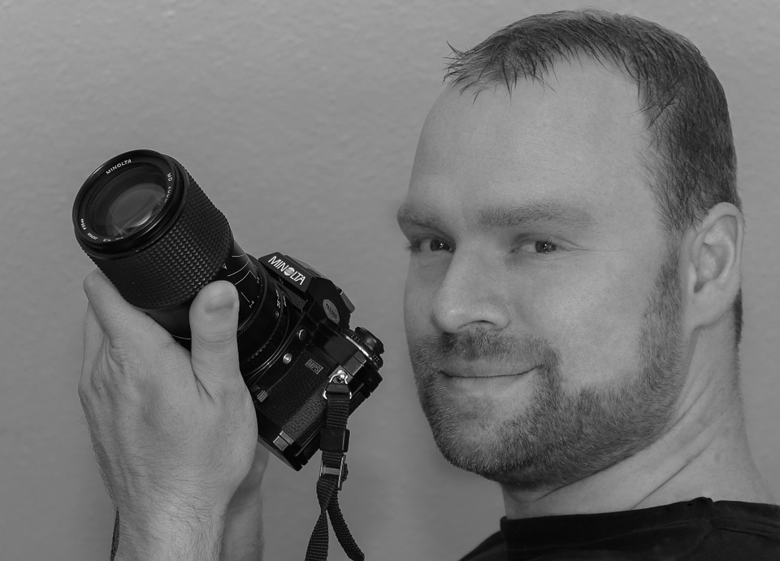
Psychological repercussions of unwarranted interference
Stress 64%
Anxiety 47%
Fear for personal safety 27%
Depression 24%
Burn-out 15%

Slide 18
Impact of unwarranted interference
40% personal life was affected
37% work was affected

Slide 19
Resulting self-censorship trend:
“nervousness about doing more reporting on the same theme”;
“changed the lead and focus of a story from an individual within the organisation to the organisation itself”
“I double checked my science and left some data out”;
“little bit reserved with other “powerful” stories”;
“not being able to report all the facts at hand”.

Slide 20
Self censorship
23% withhold information
19% shape content to suit company’s interest
15% abandon sensitive critical stories
31% tone down sensitive, critical stories

Slide 21
Experiences of increased resilience (36%):
One respondent said the experience maid him “tougher”, whilst another said that the interference made him “more determined to resist pressure”;
A journalist summarised this re-interpretation of a negative situation by saying, “ I learned to appreciate a reasonable amount of hateful comments: they only mean that my writing has relevance!”.

Slide 22
Unwarranted interference by region
Physical assault highest in the South Caucasus region, closely followed by Turkey, but presented high prevalence in the other regions as well, including EU and non-EU Western Europe.
The experience of threats with force was highest in Turkey but very closely followed by South Caucasus and Eastern Europe.
Sexual harassment was highest in Turkey and in EU and non-EU Western Europe
Robbery and/or confiscation or destruction of property was highest in Eastern European countries and South-East European countries.

Slide 23
The experience of psychological violence was high in all regions with each region reporting percentages over the 60 percentile.
Journalists in Turkey reported the highest percentages in relation to being subjected to targeted surveillance but this was generally high across all five regions
Cyberbullying was highest in Turkey followed by South-East Europe and EU and non-EU Western Europe
Experience of intimidation from political groups and the police was highest in Turkey
Interference from interest groups was highest in the South-East European region

Slide 24
Judicial intimidation by region
23% of survey respondents claimed having experienced arrest, investigation, threat of prosecution and actual prosecution under a number of laws.
Public order laws
Eastern Europe
Defamation laws
EU and non-EU Western Europe
Public order laws
South Caucasus
Defamation laws
South-East Europe
Anti-terrorism laws, national security laws and laws protecting state interests
Turkey

Slide 25
Remedies
States to implement Recommendation CM/Rec (2016)4 on the protection of journalism and safety of journalists and other media actors in the areas of:
Prevention;
Protection;
Prosecution;
Promotion of information, education and awareness raising.

Slide 26
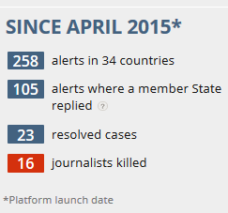
Remedies
The Council of Europe to communicate widely and engage member States in dialogue on all serious threats to media freedom reported on the on-line Platform to promote the Protection of Journalism and Safety of Journalists.
https://www.coe.int/en/web/media-freedom

Slide 27
Further references
Parliamentary Assembly Recommendation 2097 (2017) and Resolution 2141 (2017) on attacks against journalists and media freedom in Europe;
Committee of Ministers Recommendation CM/Rec(2016)4 on the protection of journalism and safety of journalists and other media actors;
Parliamentary Assembly Recommendation 2062 (2015) and Resolution 2035 (2015) Protection of the safety of journalists and of media freedom in Europe.

Slide 28
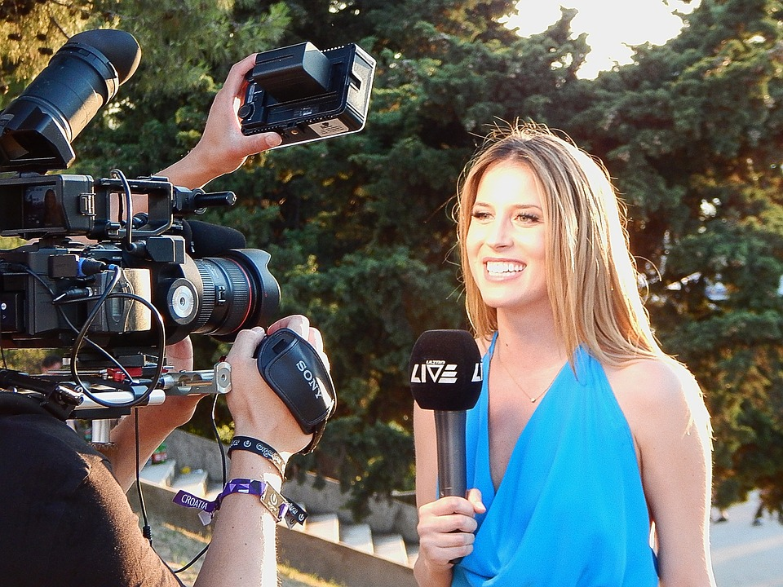
Thanks for your attention !
www.coe.int/freedomofexpression

