Slide 1
NRK – Norwegian
Broadcasting Corporation
Per Arne Kalbakk, Head of editorial ethics and standards

Slide 2
NRK: A short summary
Norway’s main public broadcaster
Non-commercial, politically independent public broadcaster
Owned by the state, but funded by the audience through annual license fee
Provides content for TV, radio, internet and mobile platforms
Publishing content both nationwide and regionally (15 regional offices)
3.400 employees
Annual budget: 5,4 billion NOK (approximately 575 million Euro)
Notes:
We reach 4 out of 5 with our content every day.

Slide 3
Editorial independence
How can NRK be independent when we are owned by the state?
Division of powers: Executive ownership by the government, but the parliament determines the charter and public obligations to the audience
We are funded by the public through the annual license fee
Every household in Norway pays 3000 NOK per year (320 Euro) in license fee to NRK (provided that they own a tv receiver)
This ensures a direct relation between NRK and the public audience
Notes:
We reach 4 out of 5 with our content every day.

Slide 4
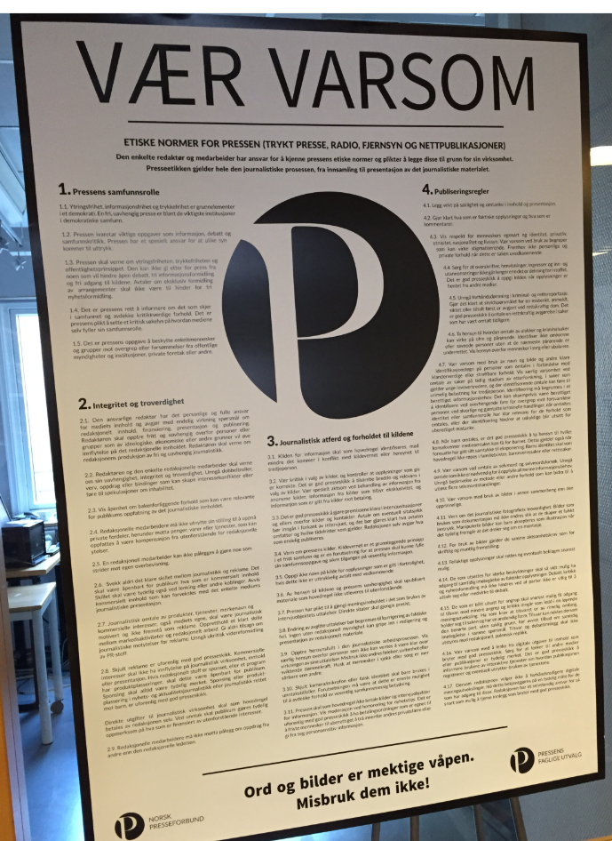
Editorial independence in Norway
The Norwegian Press Ethical Code: emphazises the independent role of media
1.1. “Freedom of Speech, Freedom of Information and Freedom of the Press are basic elements of a democracy. A free, independent press is among the most important institutions in a democratic society.”
2.1 “The editor shall act freely and independently towards any persons or groups who – for ideological, economic or other reasons – might want to exercise an influence over the editorial content.”
This principle of editorial freedom and independence is adopted in the NRK charter (§28).
The charter also states specifically the need for independence from political pressure.

Slide 5
Upholding of press ethical standards in NRK

Slide 6
Main goals for best ethical practice at the NRK
The public shall be confident that they can trust our journalism (fact checking, correction of mistakes)
Those being subject to criticism and accusations through our journalism shall be treated in a fair and reasonable manner
Our stories shall be presented in a truthful, fair and balanced manner – do not twist facts to make things look «better» or «worse» than they really are

Slide 7
The role of the Head of editorial ethics and standards
Advising editors and journalists on editorial stories (15-20 requests per day)
Responsible for implementing and upholding NRK’s ethical framework
Training of editorial staff in NRK in ethical methods and standards (at least one workshop per year for every editorial department)
Handling of complaints to the Norwegian press complaints commission
Participating on behalf of NRK in the public debate on press ethics in Norway

Slide 8
Building press ethical conscience
The job is never «finished» in fulfilling ethical standards – the job must be done with every story, every day if the year
Regular ethical training of editorial staff is important, but:
Most important of all is to make press ethics a core value through daily discussions on editorial methods and ethics
It is never embarrassing to seek advise – ethical judgements are always made better when they are made through critical evaluation.

