Slide 1
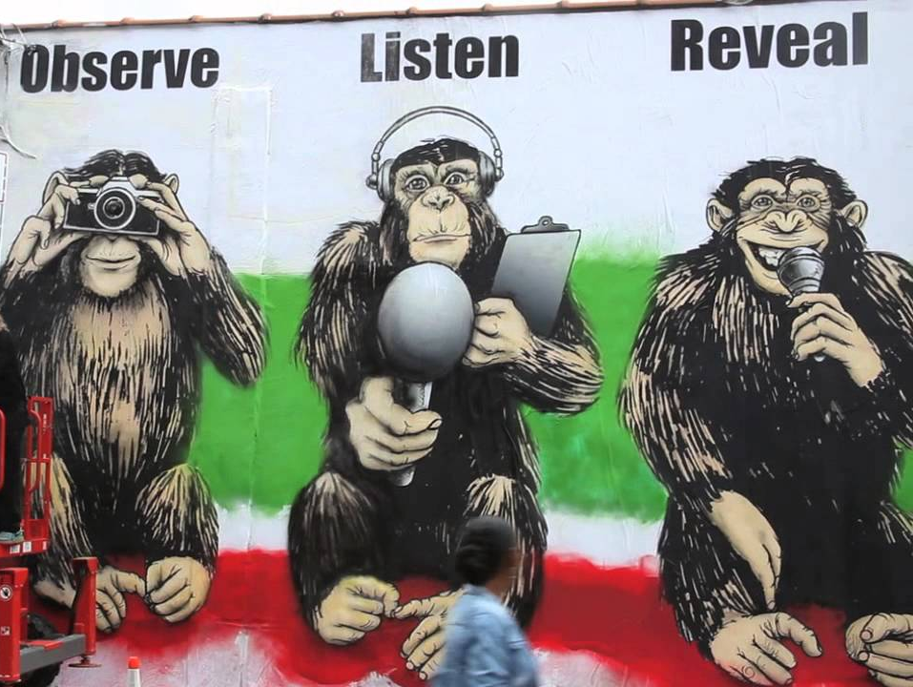
İlyas Coşkun
Journalists’ Union of Turkey (TGS)
Occupational Rights Officer
ilyas@tgs.org.tr
OBSERVE . LISTEN . REVEAL. PILLARS OF THE FOURTH ESTATE. RON ENGLISH RE-INTERPRETS THE THREE WISE MONKEYS FOR #NOTACRIMECAMPAIGN (PHOTO © JAIME ROJO)

Slide 2
The Pandemic and its impacts: Changing and remaining issues for journalists in Turkey
According to the 2021 World Press Freedom Index published by the RSF, Turkey ranks 153rd among 183 countries. Considering Global Rights Index published by the ITUC, Turkey has been among ‘the ten worst countries for working people’ without interruption since 2016.
While there were 135 journalists behind bars in April 2019, the number has dropped to 36 in September 2021.
While the total unionisation rate in the sector was only %7,49 at the beginning of 2019, the rate is now %8,4.
In the Turkish media industry, teleworking has been distinguished as a solid alternative to prevent coronavirus spread since March 2020.

Slide 3
The Pandemic and its impacts: Changing and remaining issues for journalists in Turkey
Before the pandemic broke out, TGS had only 7 Collective Bargaining Agreements (CBAs) in the sector. These media outlets are Reuters News Agency, Evrensel Newspaper, 9 Eylül Newspaper, Gazete Duvar, Bianet, Yön Radio and Refinitiv. Besides, the union has achieved to gain the majority in 7 new media outlets (BBC, AFP, AP, Cumhuriyet, İz Gazete, Halk TV and Dokuz 8 Haber) from August 2020 until May 2021.

Slide 4
Legal regulations for protecting employment against impacts of the pandemic
The Turkish government, AKP, introduced a ban on the dismissal of employment contracts from April 2020 until June 2021.
In addition to the termination ban, the government implemented a unilateral unpaid leave until June 2021. According to the regulation, employers had the right to leave their workers entirely or partially on unpaid leave.
The ruling party also introduced a short-time working allowance from March 2020 until March 2021.
The government made a teleworking bylaw in March 2021 within the scope of the Labour Law.

Slide 5
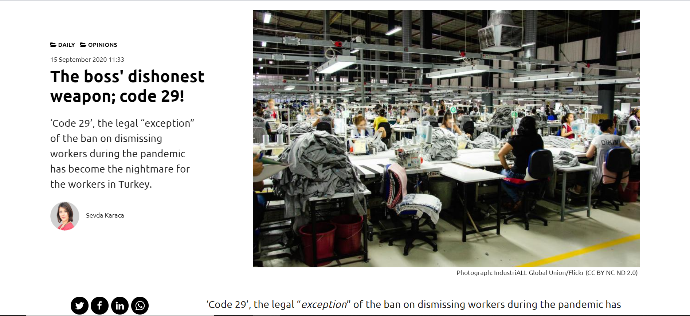

Slide 6
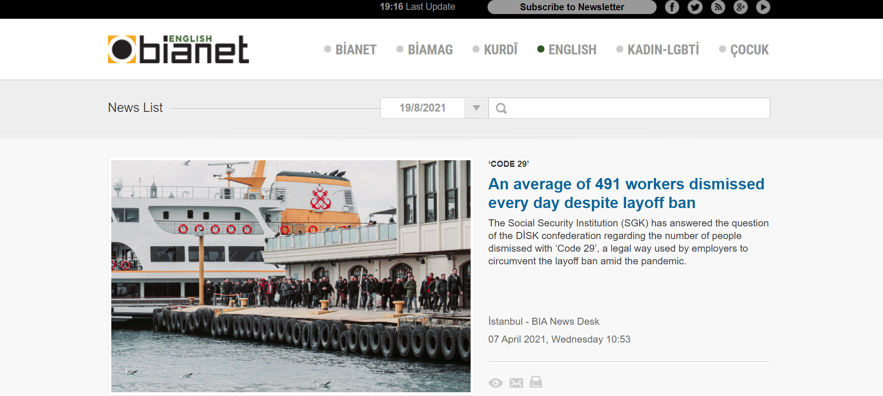

Slide 7
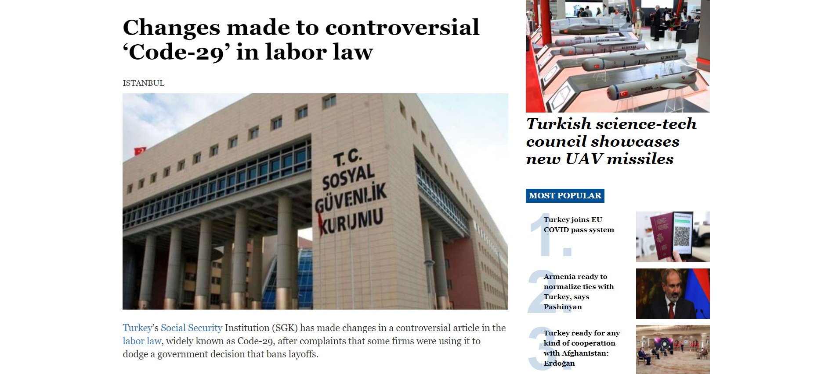

Slide 8
Legal regulations for protecting employment against impacts of the pandemic
The Turkish government, AKP, introduced a ban on the dismissal of employment contracts from April 2020 until June 2021.
In addition to the termination ban, the government implemented a unilateral unpaid leave until June 2021. According to the regulation, employers had the right to leave their workers entirely or partially on unpaid leave.
The ruling party also introduced a short-time working allowance from March 2020 until March 2021.
The government made a teleworking bylaw in March 2021 within the scope of the Labour Law.

Slide 9
Legal regulations for protecting employment against impacts of the pandemic
According to the bylaw:
Employers must sign a contract with their remote workers.
The contract must include details such as the definition of the work that will be performed, type of work, work duration and the place of work, work equipment provided by the employer, and remuneration.
The bylaw bans any discrimination against remote workers for the nature of their employment contracts.
The employers shall provide information and training to remote workers.
Employers are obligated to inform remote workers and provide training about occupational health and safety precautions.

Slide 10
TGS’s Activities
After the pandemic broke out, the union has called all employers to implement teleworking to protect media workers.
The union has called for adequate occupational health and safety measures, especially for reporters who have to work in the field.
In March 2020, the union organised a web page to inform employees about their legal rights.
In March 2021, the union published a report covering the impacts of the pandemic and teleworking in the last year.

Slide 11
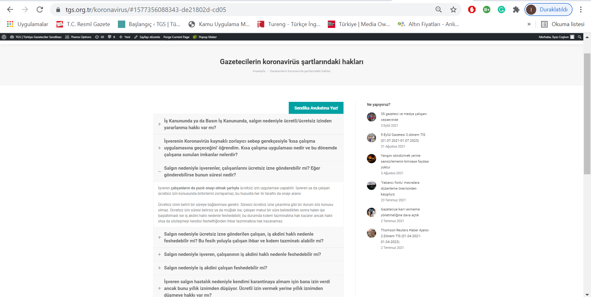

Slide 12
TGS’s Activities
After the pandemic broke out, the union has called employers to implement teleworking to protect media workers.
The union has called for adequate occupational health and safety measures, especially for reporters who have to work in the field.
In March 2020, the union organised a web page to inform employees about their legal rights.
In March 2021, the union published a report covering the impacts of the pandemic and teleworking in the last year.

Slide 13
TGS’s Activities
Problems said by employees are as follow:
A decline monthly income because of the short-time working allowance,
Forced to work full-time by employers despite being on a short-time working allowance,
A decline in monthly income due to unpaid leave,
An increase in their workloads at work and home,
Lacking adequate tools and materials for teleworking,
A rise in unpaid overtime during teleworking,
A decrease or cut the lunch voucher payment completely due to teleworking
Inadequate occupational health and safety measures both in workplaces and telework.
More precarious working conditions.

Slide 14
TGS’s Activities
After publishing the report, the union announced a “Teleworking Guideline”.
Suggestions in the guideline:
Regulations on teleworking should be in line with ILO standards.
Teleworking should be organised on a voluntary basis.
There should be no discrimination among workers employed remotely or in the workplace regarding promotion, training, economic and social benefits.
Employers should guarantee decent and fair working conditions for remote workers.
Employers should show respect collective rights of remote workers.
Working hours and breaking times should clearly be determined within the limits of the law.
Employers should respect the “right to disconnect” out of working hours.
In overtime working, remote workers should continue to receive payment in line with the labour act.

Slide 15
TGS’s Activities
After publishing the report, the union announced a “Teleworking Guideline”.
Suggestions in the guideline:
Employers should support adequate equipments required for teleworking. Expenses related to teleworking (electric, water, gas, mobile phone, internet bill and so on) should be included in the agreement.
Employers should continue to take responsibility for occupational health and safety measures for remote workers.
Employers should respect the right to privacy for remote workers. They should limit the activities of the monitoring tools used for business purposes.
Employers should inform adequately remote workers about cyber security and provide them with relevant software before starting teleworking.

Slide 16
TGS’s Activities
At seven of the total unionised companies, teleworking is currently in progress. The union has provided decent wages and fair working conditions for remote workers in the signed collective agreements in harmony with the “Teleworking Guideline”.
The union has used all activities (legal support, publishing a report and press statements, “Teleworking Guideline”, and successful collective bargaining negotiations) as leverage to increase the number of unionised companies (from 7 to 14 in total).

